Slide 1
Problem Statement :
Fully Autonomous Drone for GPS denied operations and various mission capabilities.
Missions :
1) Drop a Payload 2) Track a Person/Drone.
3) Surveillance of an Area

Slide 2
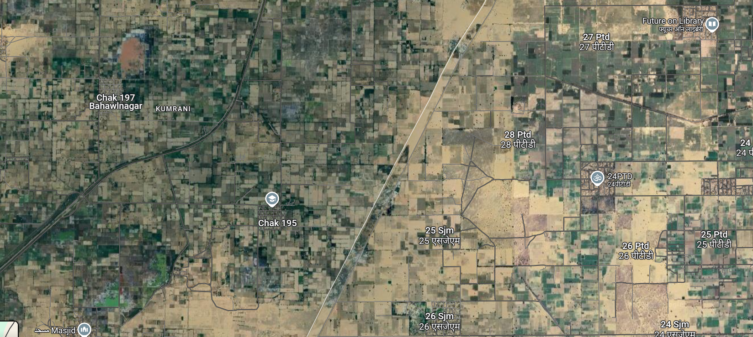

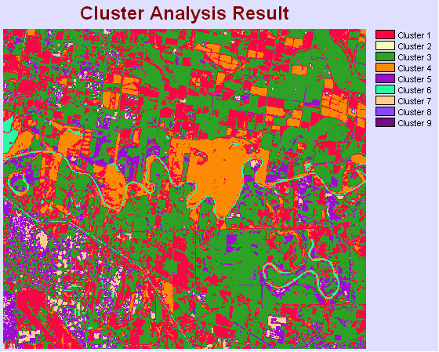
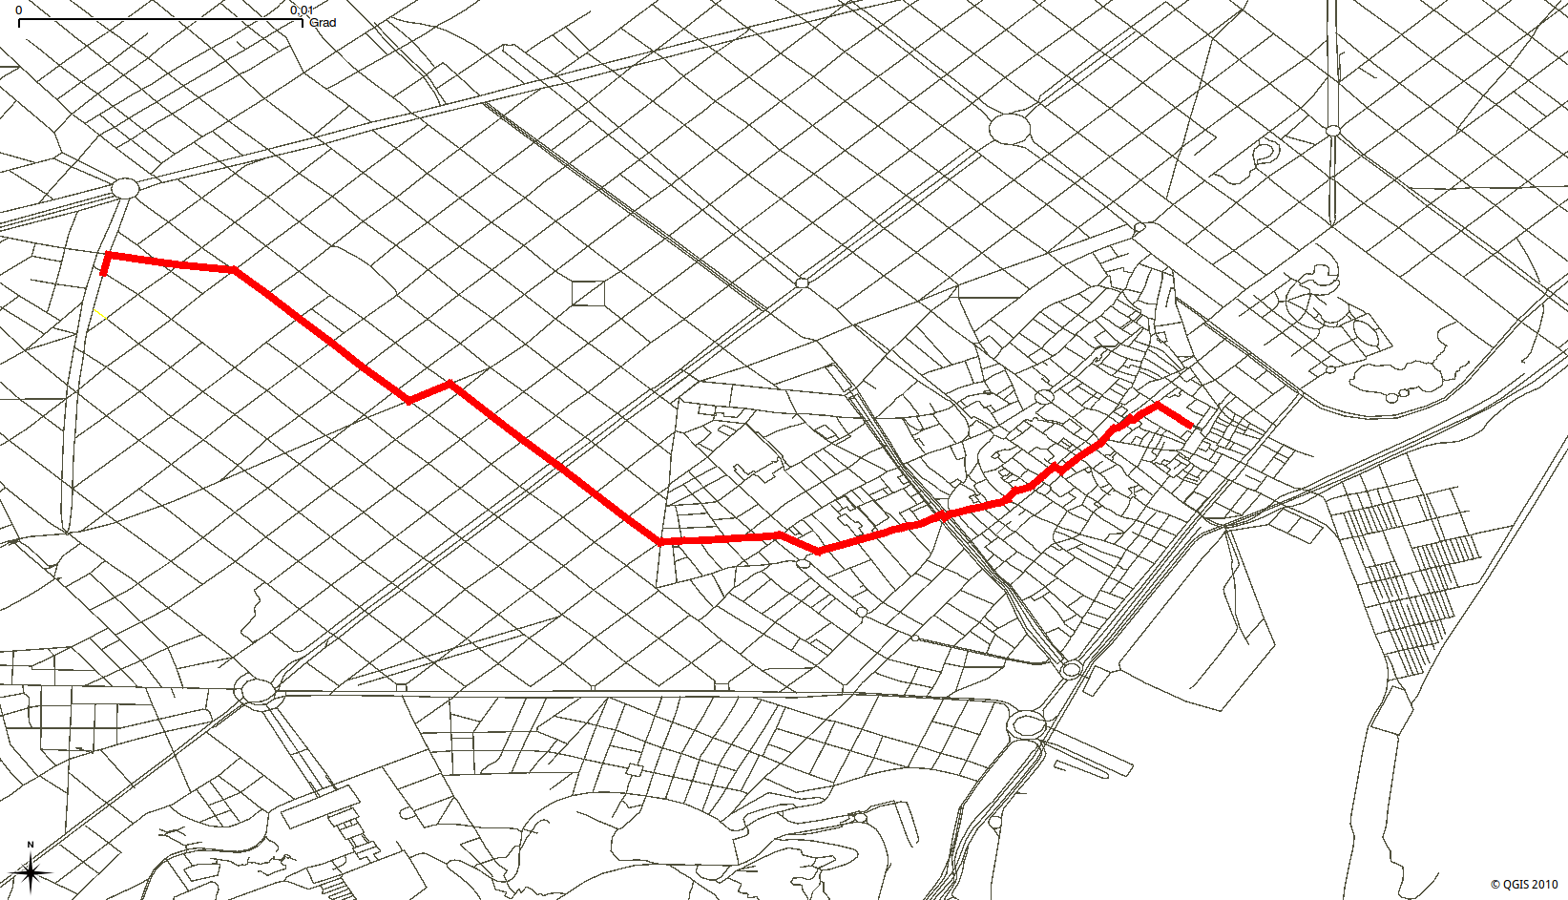
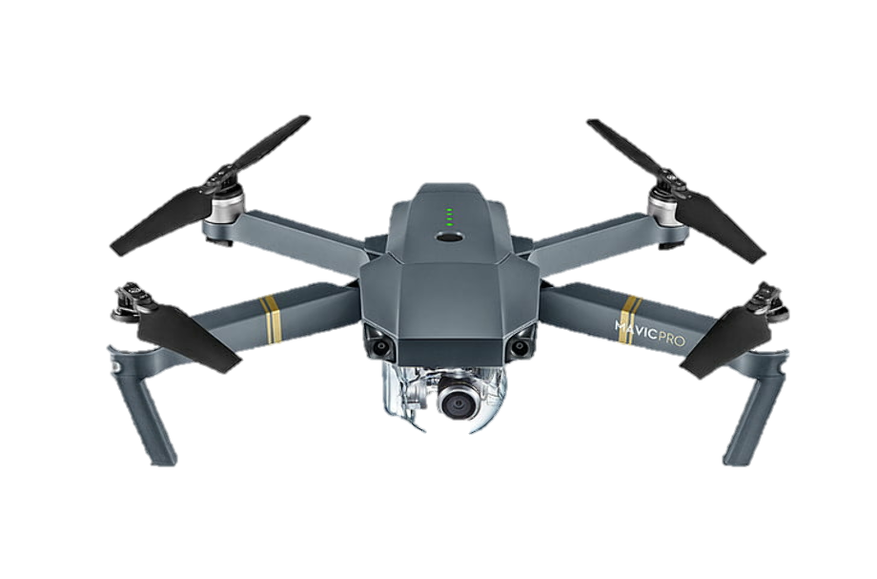

Phase 1 : Autonomous Drone and Path Planning
Project Overview :
STEP1
STEP 2
Satellite Image
Segmented Image
Flight Plan
STEP 3
STEP 4
Drone
Mission Data
Path Prediction

Slide 3

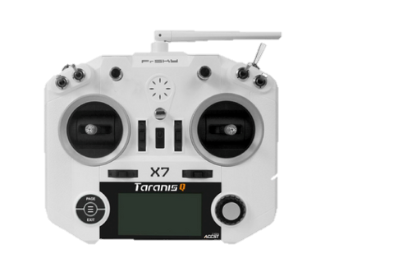
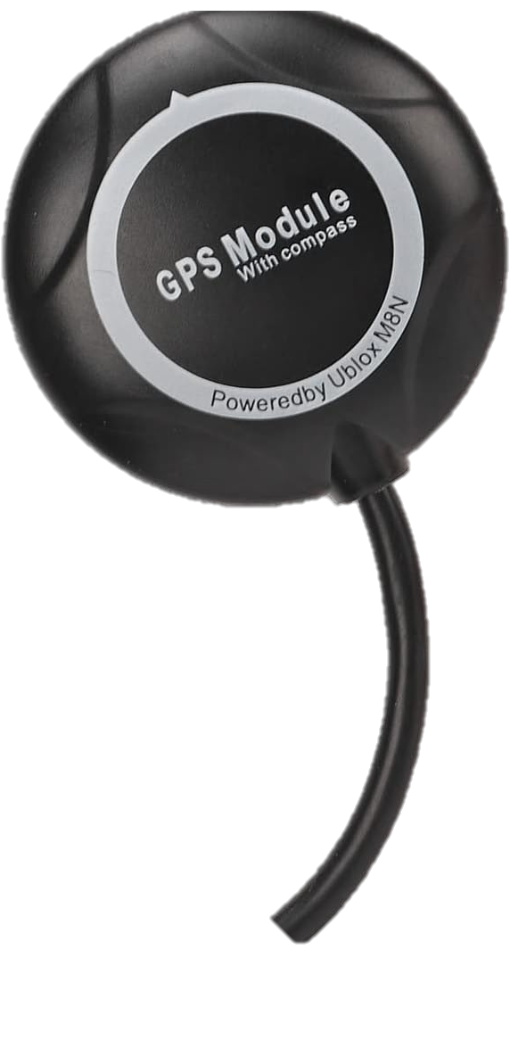
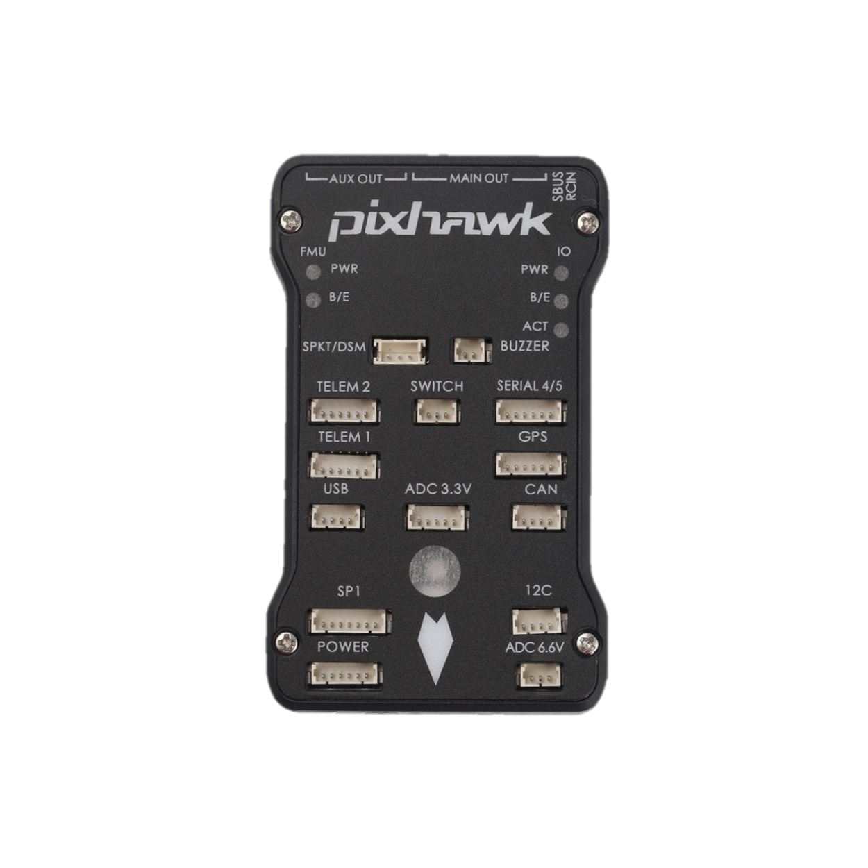
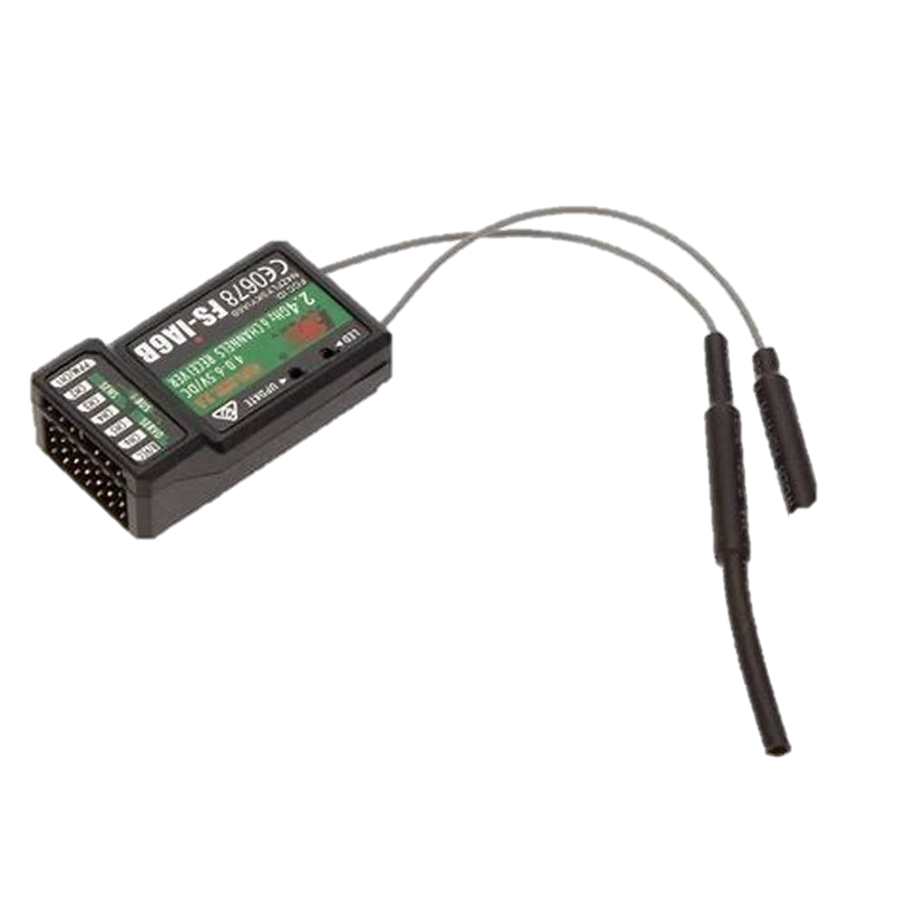
Normal Scenario
GPS
Transmitter
Normal Drone
Flight Controller
Receiver

Slide 4
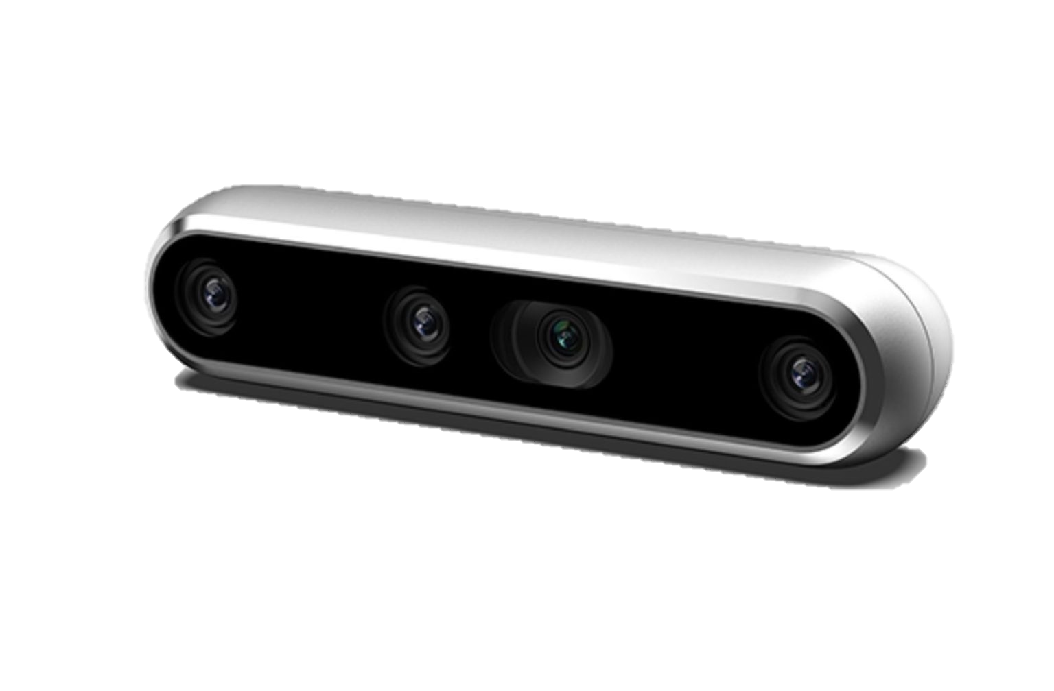
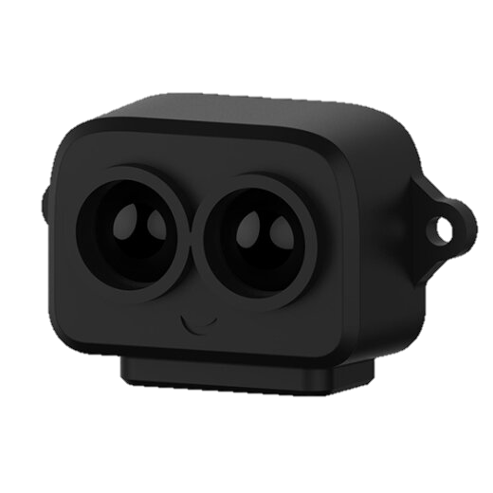
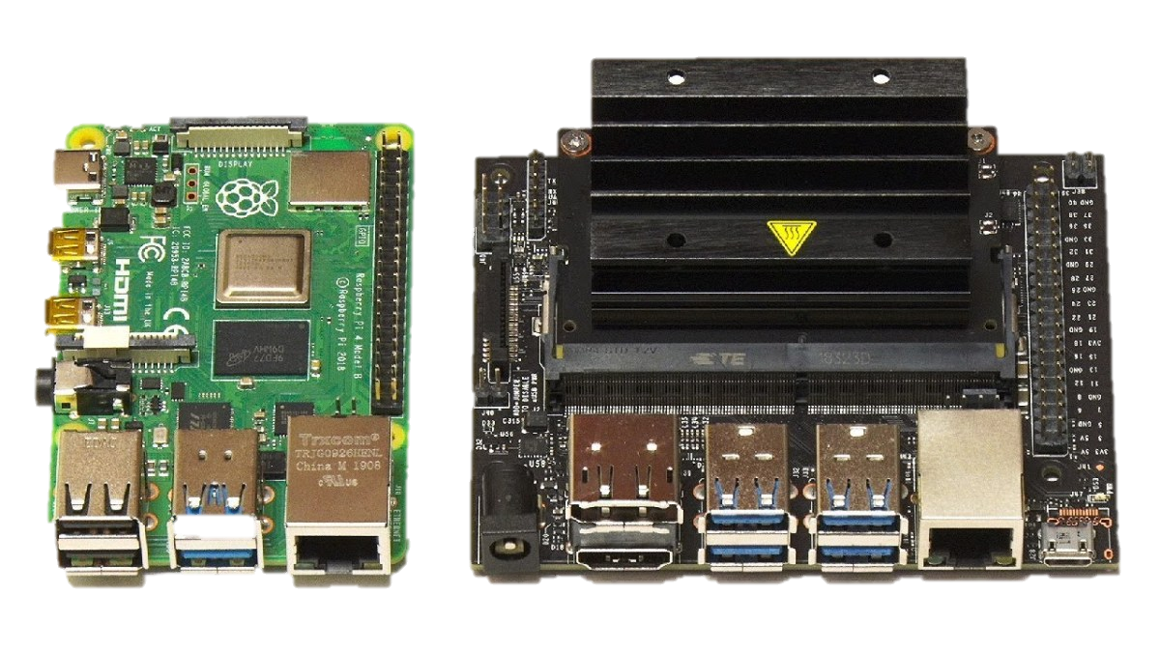
1 D lidar
Stereo Depth Camera
GPS DATA
Drone
GPS DATA + Flight Instructions
Raspberry Pi or Jetson Nano

Slide 5
Phase 2 : Adding Obstacle Avoidance, height/speed Dynamics and Mission Capabilities
Obstacle Avoidance
Cameras and Ultrasonic
sensors
3) Drop a Payload
Adding a dropping
mechanism using servo Software enhancement.
4) Track Person and Engage
AI Integration with cameras and explosive
integration
Height and Speed
Dynamics
Software enhancement.
5) Surveillance
Camera and streaming Capabilities.

